Slide 1



AWS Training - Session 3
Dr. Prabhakar PhD
Senior Integration Engineer
Decision Minds, Bengaluru.

Slide 2
Contents
S3 Pricing
S3 Request Types
AWSCLI
Elastic Compute Cloud Part I

Slide 3
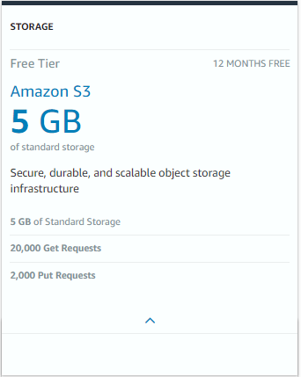

AWS Simple Storage Service

Slide 4
S3 Pricing
The amount of storage.
The amount of data transferred every month.
The number of requests made monthly.

Slide 5
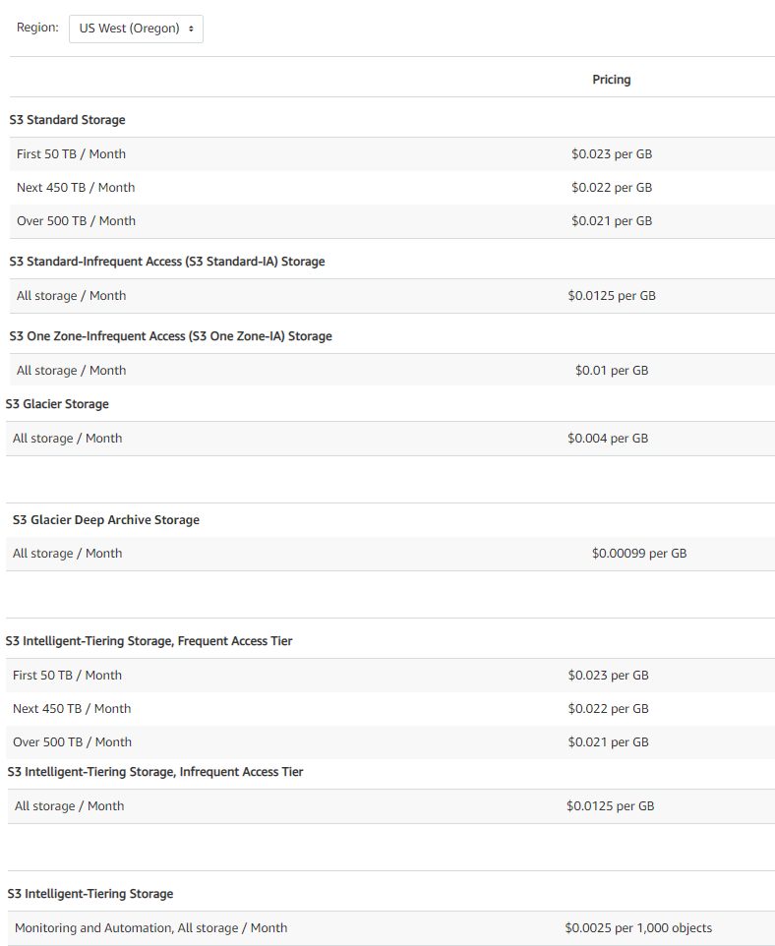
Storage Pricing
minimum billable object size of 128KB.

Slide 6
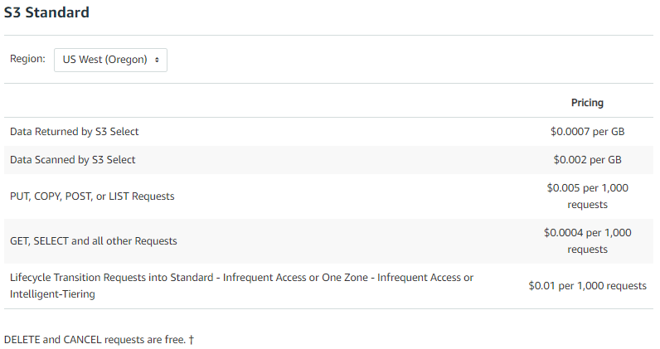
Request Pricing

Slide 7
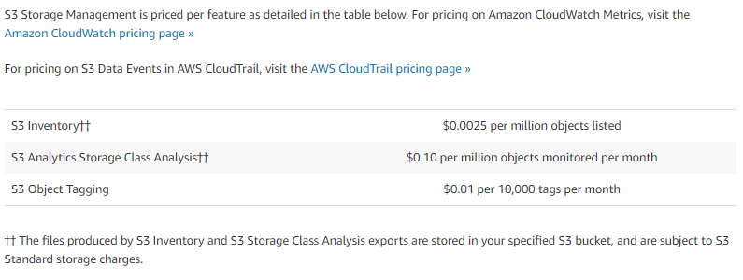
Storage Management Pricing

Slide 8

Data Transfer Pricing

Slide 9
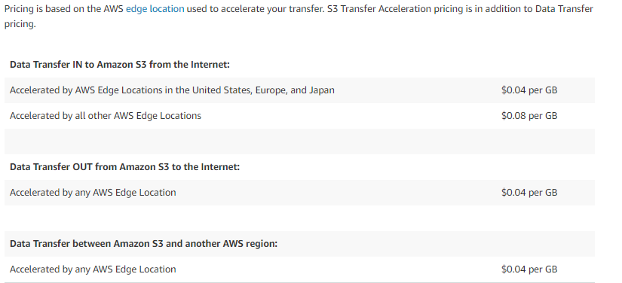
Transfer Acceleration Pricing
AWS edge location is where the AWS uses to cache copies of your content for faster delivery to users at any location.

Slide 10
Transfer Acceleration
Amazon S3 Transfer Acceleration enables fast, easy, and secure transfers of files over long distances between your client and an S3 bucket.
Why?
You might want to use Transfer Acceleration on a bucket for various reasons, including the following:
You have customers that upload to a centralized bucket from all over the world.
You transfer gigabytes to terabytes of data on a regular basis across continents.
You are unable to utilize all of your available bandwidth over the Internet when uploading to Amazon S3.

Slide 11
Cross-Region Replication pricing
CRR is an Amazon S3 feature that automatically replicates data across AWS Regions.
With CRR, every object uploaded to an S3 source bucket is automatically replicated to a destination bucket in a different AWS Region that you choose.
You pay the Amazon S3 charges for storage, requests, and inter-region data transfers for the replicated copy of data in addition to the storage charges for the primary copy.
Pricing for the replicated copy of storage is based on the destination region, while pricing for requests and inter-region data transfers are based on the source AWS Region.

Slide 12
S3 Request Types
PUT
POST
LIST
COPY
GET
HEAD
DELETE
adds an object to a bucket.
adds an object to a specified bucket
returns some or all of the objects in a bucket.
operation creates a copy of an object
retrieves objects from Amazon S3
to determine if a bucket exists and you have permission to access it
deletes object or a bucket

Slide 13




Management Interface
CLI
http://aws.amazon.com/cli/
Management
Interface
SDK
http://aws.amazon.com/tools/
Web
http://aws.amazon.com/console/

Slide 14
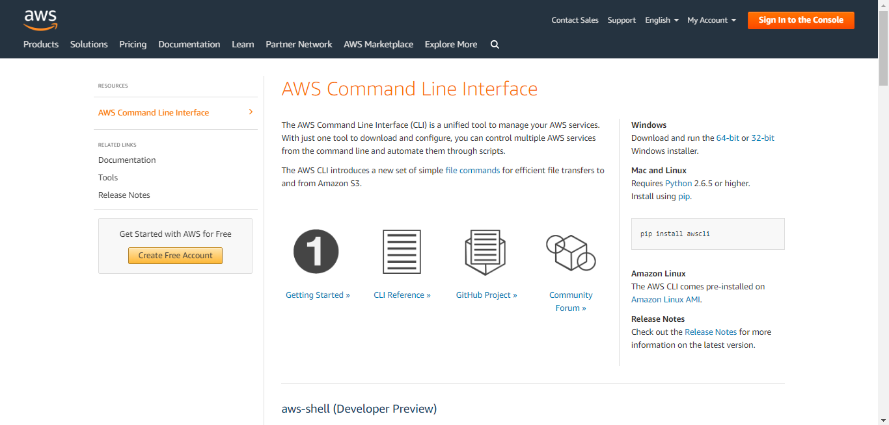
AWSCLI

Slide 15
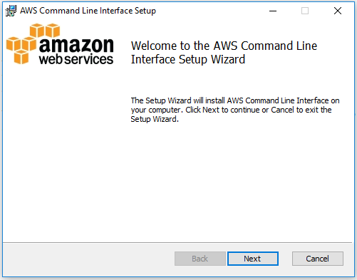
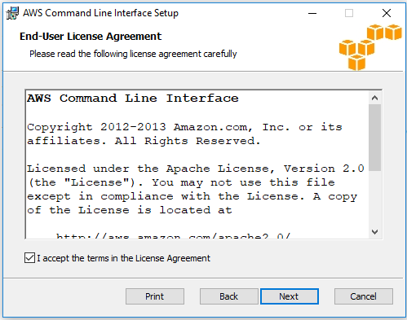
AWSCLI

Slide 16
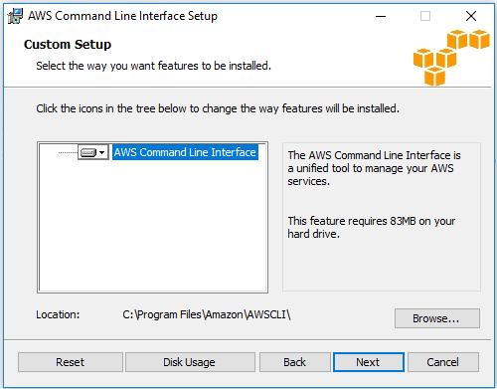
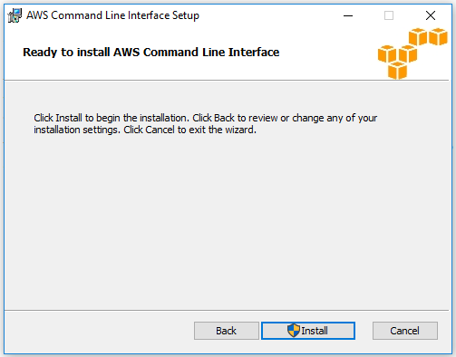
AWSCLI

Slide 17
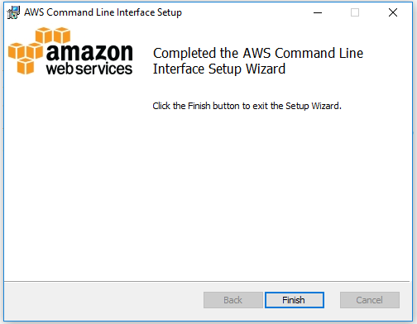
AWSCLI

Slide 18
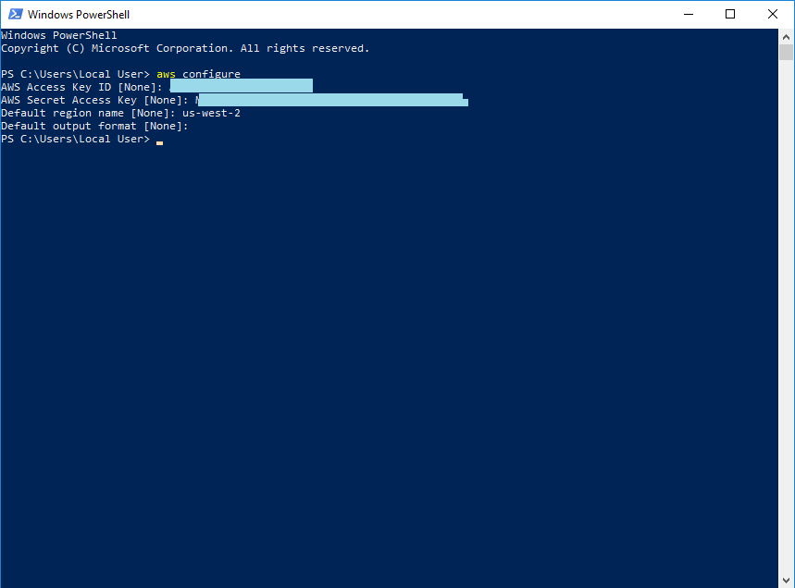
AWSCLI

Slide 19
AWSCLI
Creating a Bucket
aws s3 mb s3://prabhakar8799099 --region us-west-2
Upload a file to bucket
aws s3 cp C:\sie\ s3://prabhakar8799099 --recursive --exclude "*" --include "*.txt"
Delete object in a bucket
aws s3 rm s3 ://prabhakar8799099 /Perl.txt
Delete a bucket
aws s3 rb s3://prabhakar8799099
aws s3 rb --force s3://prabhakar8799099

Slide 20
Management Interface
CLI
http://aws.amazon.com/cli/
Management
Interface
SDK
http://aws.amazon.com/tools/
Web
http://aws.amazon.com/console/

Slide 21
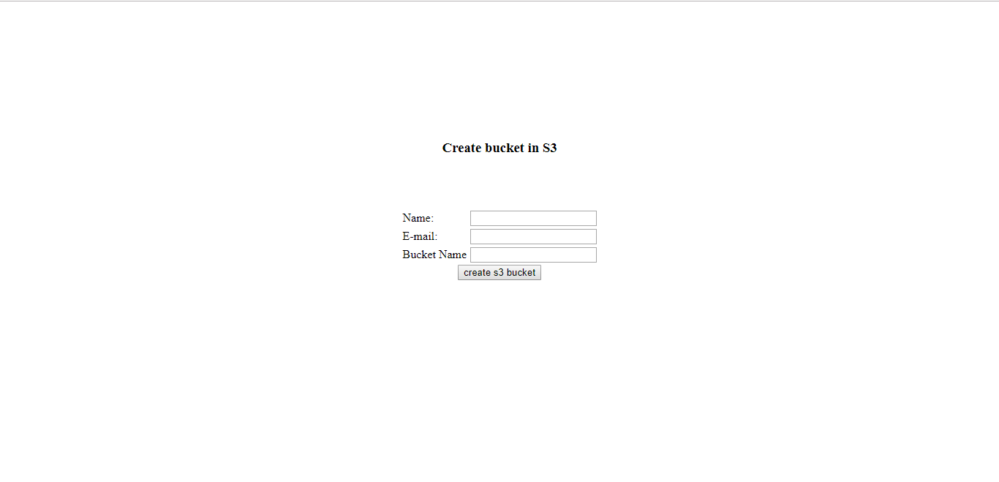
AWS SDK – S3 (PHP)

Slide 22

AWS SDK – S3 (PHP)
<?php
require ‘aws-autoloader.php';
use Aws\S3\S3Client;
use Aws\Exception\AwsException;
$BUCKET_NAME= =$_GET["bname"];
//Creating S3 Bucket
try {
$result = $s3Client->createBucket([
'Bucket' => $BUCKET_NAME,
]);
}catch (AwsException $e) {
// output error message if fails
echo $e->getMessage();
echo "\n";
}
?>

Slide 23

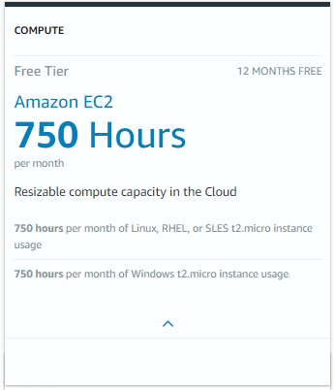
Elastic Compute Cloud
On demand computing resources
Eliminate the need of far ahead planning
No up-front commitment
Start small and grow as required
No contract, Only credit card!
Pay for what you use
No maintenance
Measured service
Scalability
Reliability

Slide 24
Elastic Compute Cloud – Payment Methods
On-Demand Instances let you pay for compute capacity by the hour with no long-term commitments.
Reserved Instances give you the option to make a low, one-time payment for each instance you want to reserve and in turn receive a significant discount on the hourly charge for that instance.
Spot Instances allow customers to bid on unused Amazon EC2 capacity and run those instances for as long as their bid exceeds the current Spot Price.

Slide 25
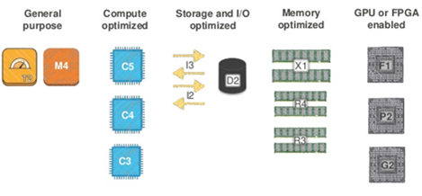
Elastic Compute Cloud – Types of Instances
Subtypes
General Purpose – (T2, M4, M3)
Computer Optimized – (C5, C4, C3)
Memory Optimized – (X1, R4, R3)
Accelerated Computing (P3, P2, G3, F1)
Storage optimized-(I3)
Dense-storage Instances – (D2)
Large
Xlarge
2xlarge
4xlarge
8xlarge

Slide 26
Elastic Compute Cloud – Elastic Block Store
Provides block level storage volumes (1 GB to 1 TB ) for use with Amazon EC2 instances.
Multiple volumes can be mounted to the same instance.
EBS volumes are network-attached, and persist independently from the life of an instance.
Storage volumes behave like raw, unformatted block devices, allowing users to create a file system on top of Amazon EBS volumes, or use them in any other way you would use a block device (like a hard drive).
EBS volumes are placed in a specific Availability Zone, and can then be attached to instances also in that same Availability Zone.
Each storage volume is automatically replicated within the same Availability Zone.
EBS provides the ability to create point-in-time snapshots of volumes, which are persisted to Amazon S3.
These snapshots can be used as the starting point for new Amazon EBS volumes, and protect data for long-term durability.
The same snapshot can be used to instantiate as many volumes as you wish.
These snapshots can be copied across AWS regions.

Slide 27
Elastic Compute Cloud – Elastic Block Store
Standard volumes offer storage for applications with moderate or bursty I/O requirements.
Standard volumes deliver approximately 100 IOPS on average.
well suited for use as boot volumes, where the burst capability provides fast instance start-up times.
Provisioned IOPS volumes are designed to deliver predictable, high performance for I/O intensive workloads such as databases.
You specify an IOPS rate when creating a volume, and EBS provisions that rate for the lifetime of the volume.
Amazon EBS currently supports up to 4000 IOPS per Provisioned IOPS volume.
You can stripe multiple volumes together to deliver thousands of IOPS per EC2 instance.
To enable your EC2 instances to fully utilize the IOPS provisioned on an EBS volume,:
Launch selected Amazon EC2 instance types as “EBS-Optimized” instances.
EBS-optimized instances deliver dedicated throughput between Amazon EC2 and Amazon EBS, with options between 500 Mbps and 1000 Mbps depending on the instance type used.
EBS charges based on per GB-month AND per 1 million I/O requests

Slide 28
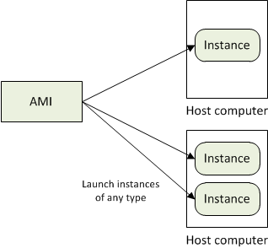
Amazon Machine Images
Amazon Machine Images (AMIs) are the basic building blocks of Amazon EC2.
An AMI is a template that contains a software configuration (operating system, application server and applications) that can run on Amazon’s computing environment
AMIs can be used to launch an instance, which is a copy of the AMI running as a virtual server in the cloud.

Slide 29
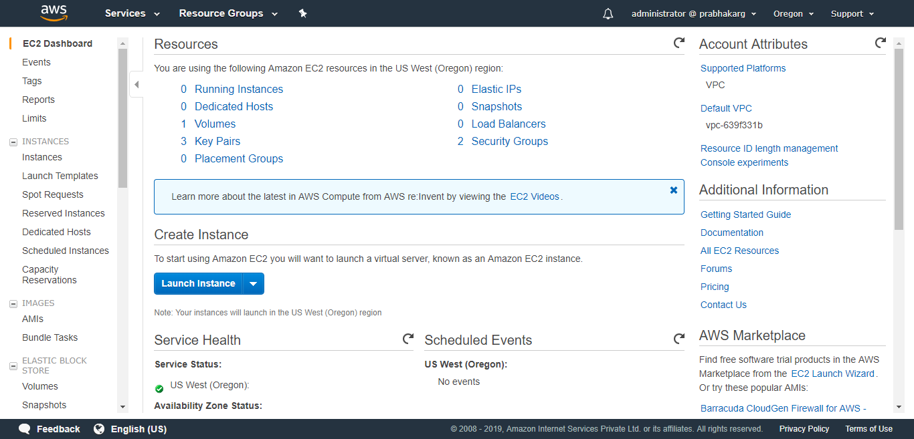
Elastic Compute Cloud
Demonstration: Linux Instance

Slide 30
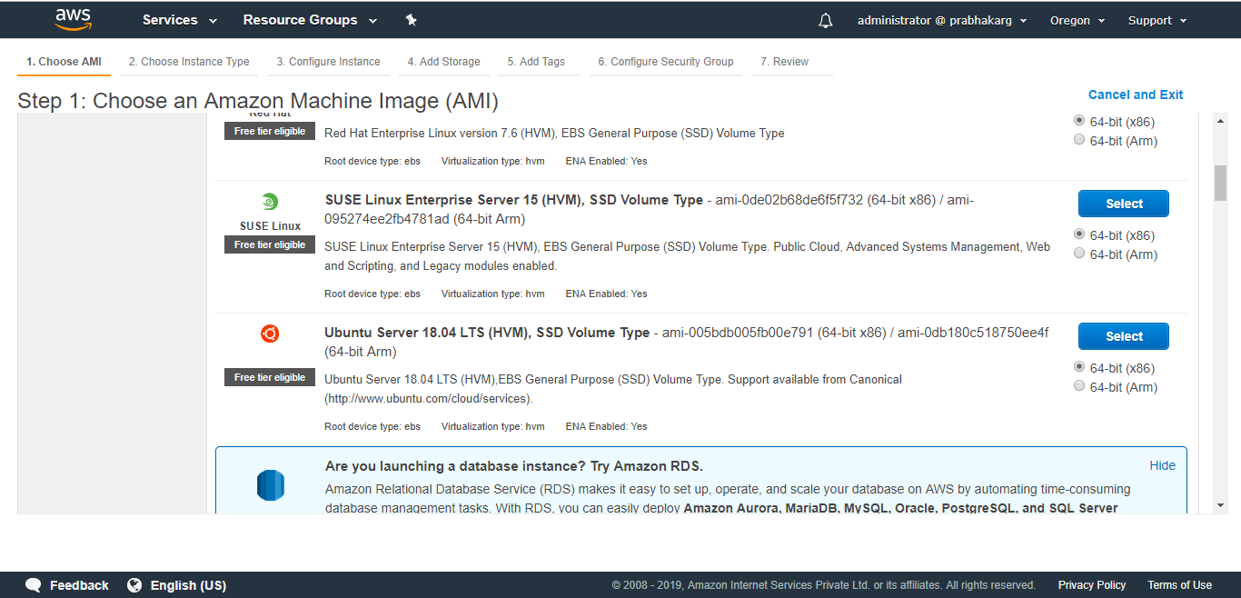
Elastic Compute Cloud

Slide 31
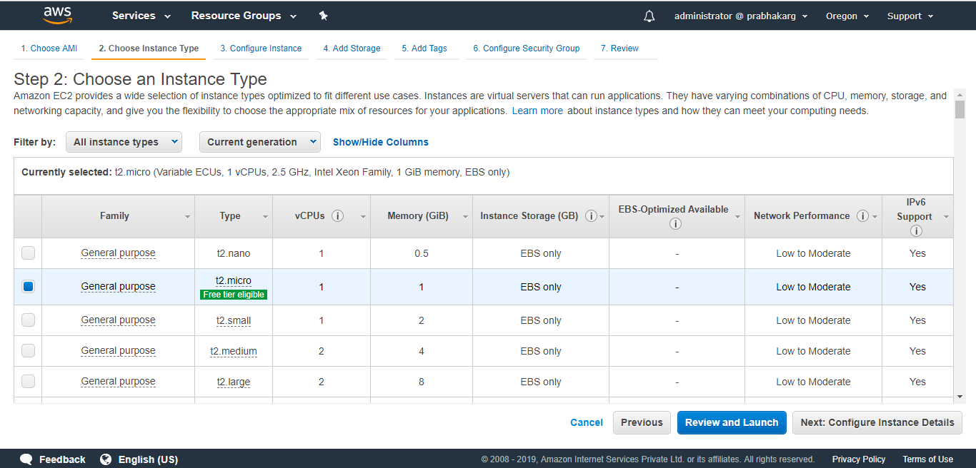
Elastic Compute Cloud

Slide 32
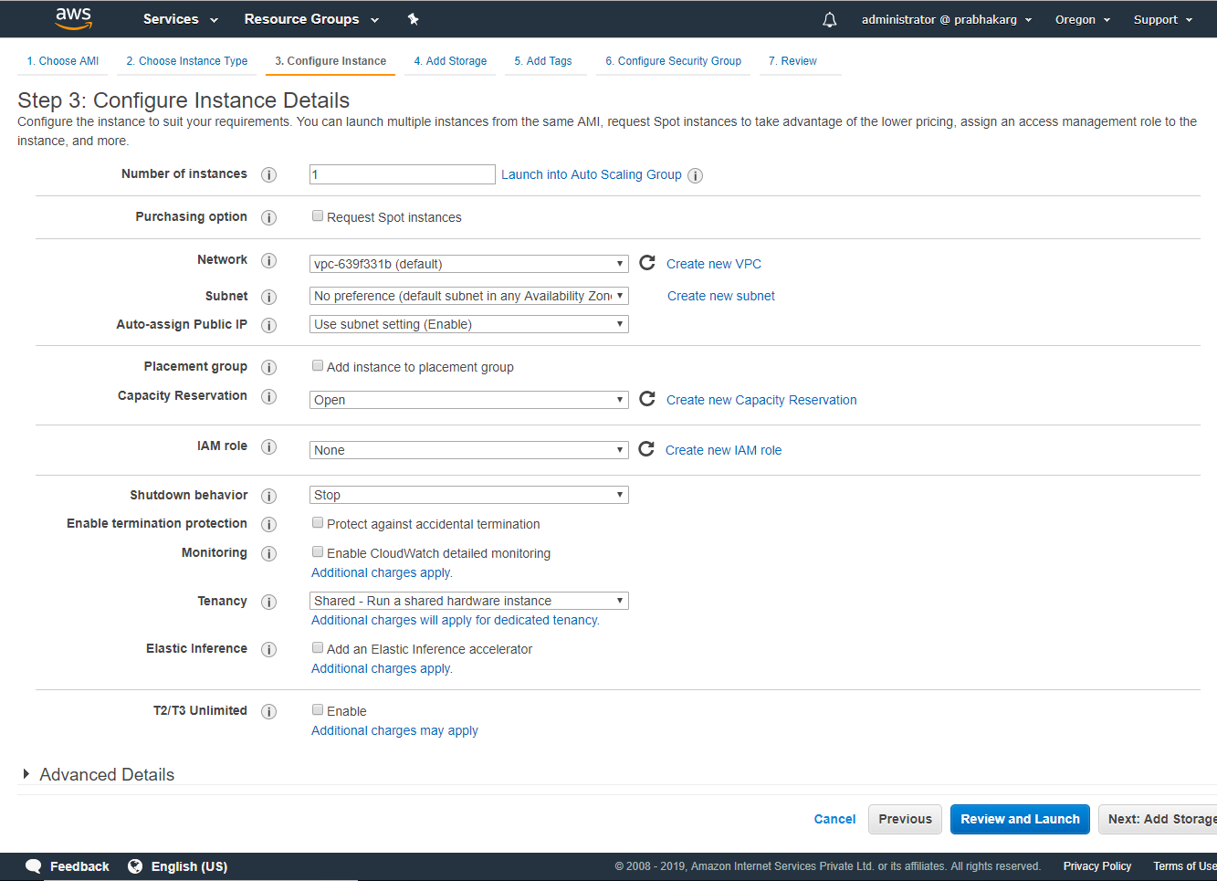

Slide 33
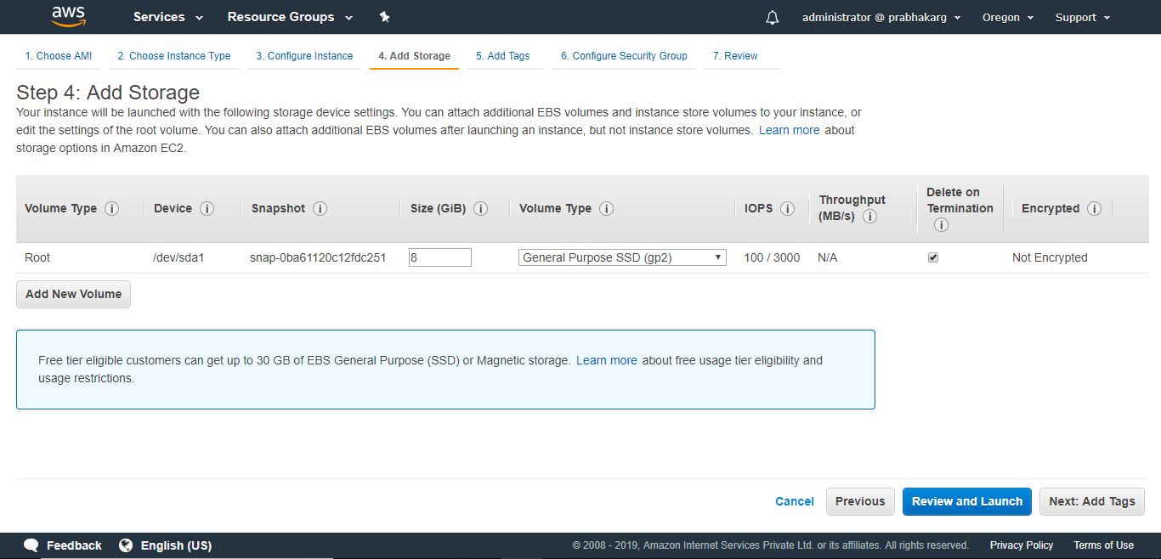
Elastic Compute Cloud

Slide 34
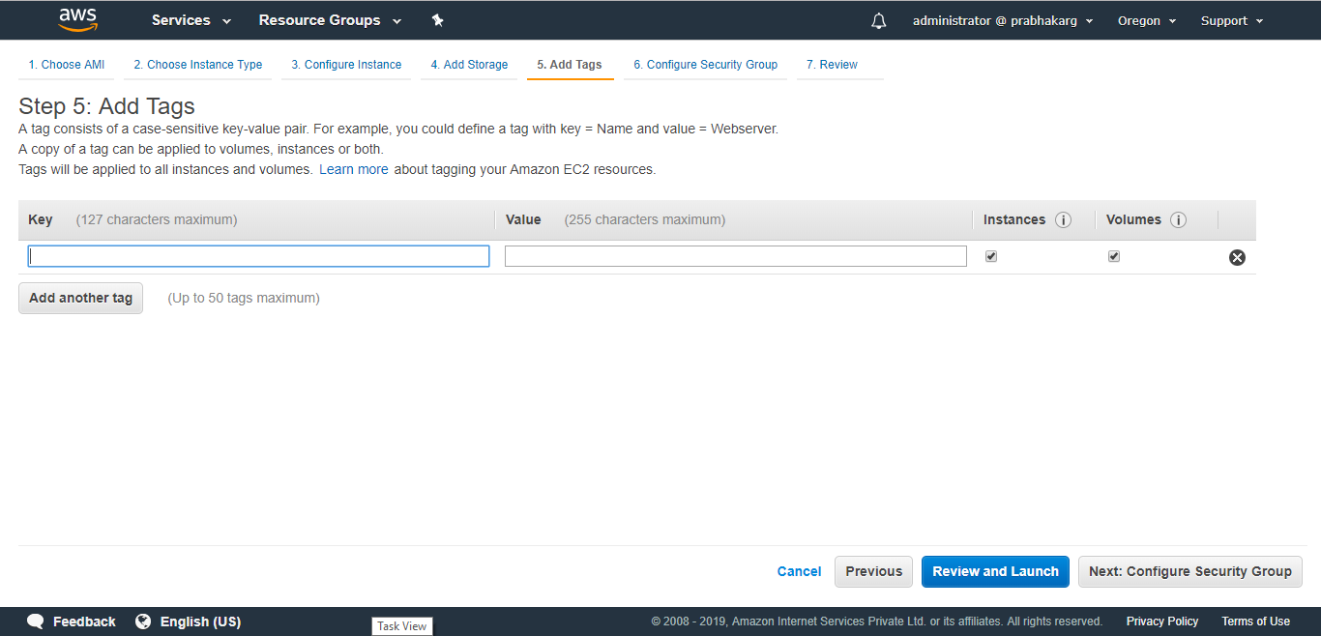
Elastic Compute Cloud

Slide 35
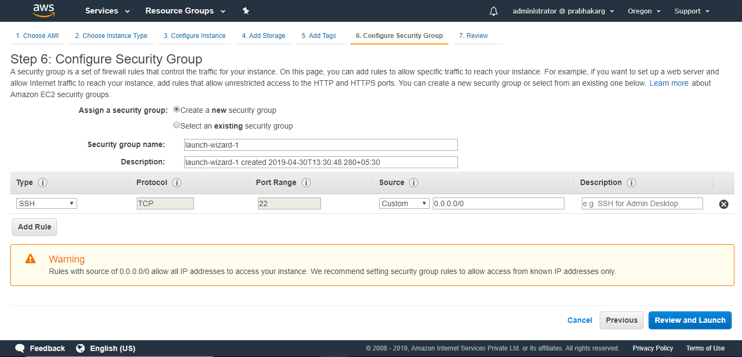
Elastic Compute Cloud

Slide 36
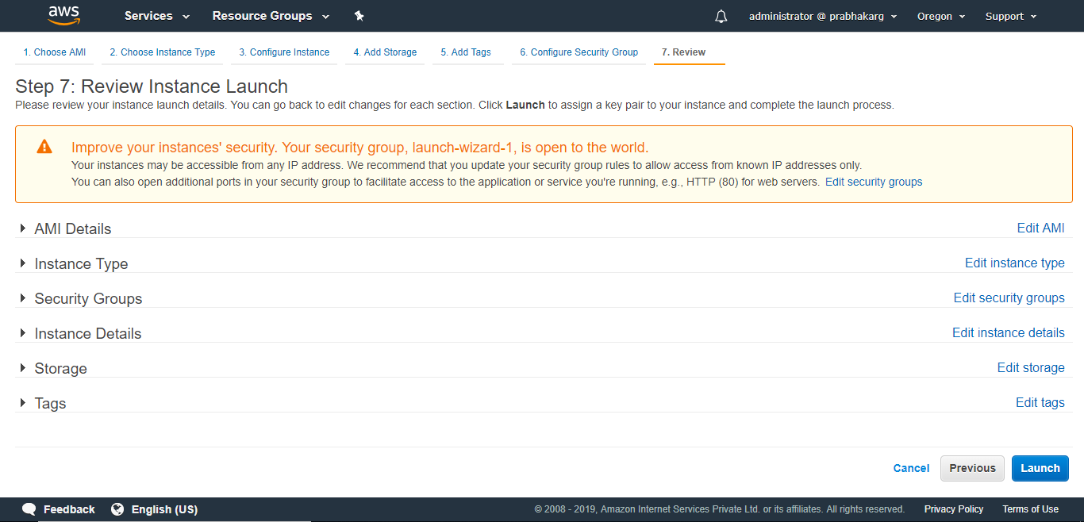
Elastic Compute Cloud

Slide 37
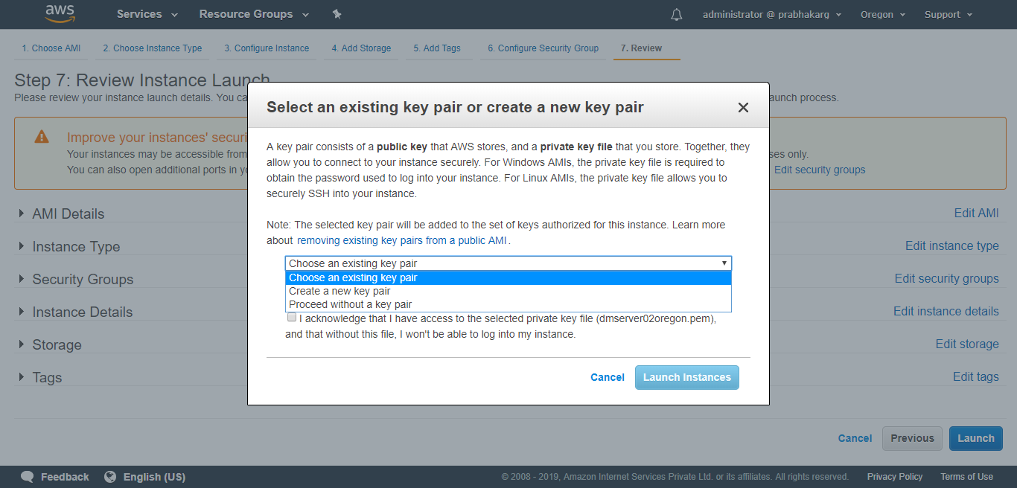
Elastic Compute Cloud

Slide 38
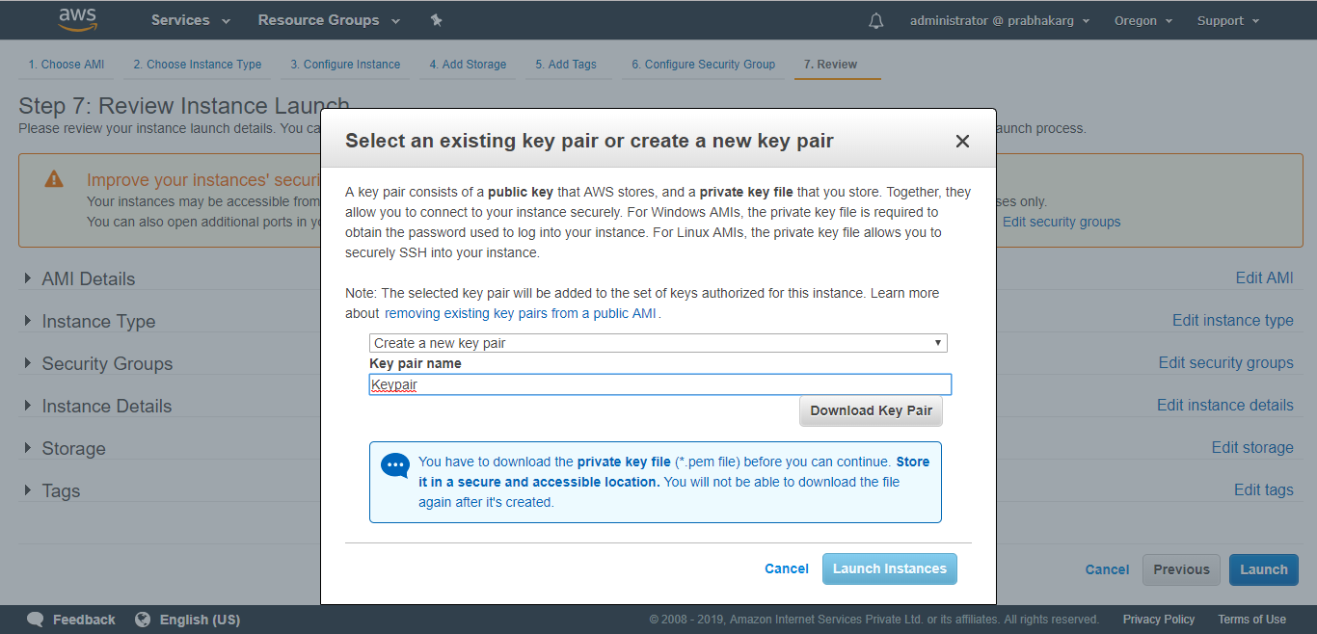
Elastic Compute Cloud

Slide 39
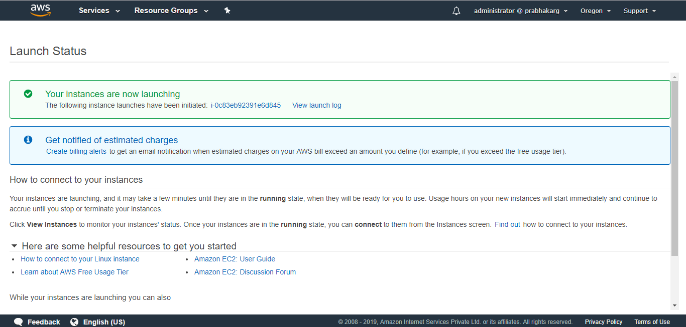
Elastic Compute Cloud

Slide 40
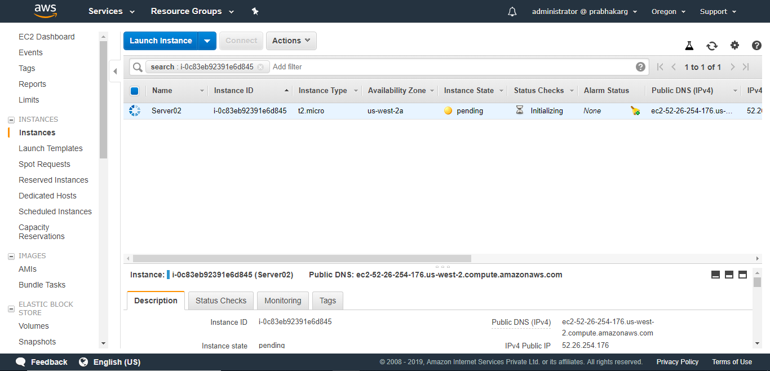
Elastic Compute Cloud

Slide 41
Connecting to an Amazon EC2 instance
There are several ways to connect to an EC2 instance once it’s launched.
Remote Desktop Connection is the standard way to connect to Windows instances.
An SSH client (standalone or web-based) is used to connect to Linux instances.

Slide 42
Connecting to Linux/UNIX Instances from Linux/UNIX with SSH
Prerequisites:
Most Linux/UNIX computers include an SSH client by default, if not it can be downloaded from openssh.org
Enable SSH traffic on the instance (using security groups)
Get the path the private key used when launching the instance
In a command line shell, change directory to the path of the private key file
Use the chmod command to make sure the private key file isn’t publicly viewable

Slide 43
Transferring files to Linux/UNIX instances from Linux/UNIX with SCP
Prerequisites:
Enable SSH traffic on the instance
Install an SCP client (included by default mostly)
Get the ID of the Amazon EC2 instance, public DNS of the instance, and the path to the private key
If the key file is My_Keypair.pem, the file to transfer is samplefile.txt, and the instance’s DNS name is ec2-184-72-204-112.compute-1.amazonaws.com, the command below copies the file to the ec2-user home

Slide 44
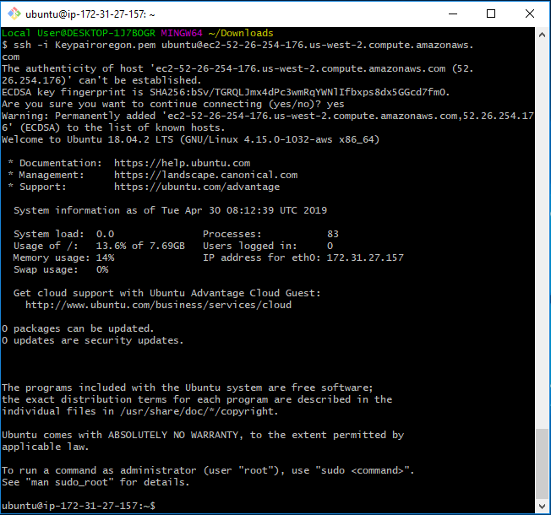
Elastic Compute Cloud

Slide 45
Terminating Instances
If the instance launched is not in the free usage tier, as soon as the instance starts to boot, the user is billed for each hour the instance keeps running.
A terminated instance cannot be restarted.
To terminate an instance:
Open the Amazon EC2 console
In the navigation pane, click Instances
Right-click the instance, then click Terminate
Click Yes, Terminate when prompted for confirmation

Slide 46
Coming Up
Elastic Compute Cloud Part II
Introduction to Virtual Private Cloud AWS VPC
Thank you

